Slide 1





PROJECT ON POWER BI
Duration: 120 Minutes
www.anudip.org
FOLLOW US ON:

Slide 2




Guidelines
Facilitator will explain the project activities by referring to the next slides.
Students will refer to this PPT to complete the project outside class.
Group members need to collaborate among themselves, brainstorm and complete the project activities outside class.
Each group needs to prepare a document or a PPT and upload the same to the LMS and present it in the Project Discussion session.
Facilitator needs to refer to the Project Discussion ppt for scoring instructions.
www.anudip.org
FOLLOW US ON:

Slide 3

Project Instructions
A problem statement along with a data set are given
Each group can download the data set from their LMS account
Each group needs to analyse data, prepare related visual representations for the given tasks, determine actionable insights, and present them in form of a presentation.
Each group needs to share the given task equally among their members.
www.anudip.org
FOLLOW US ON:

Slide 4
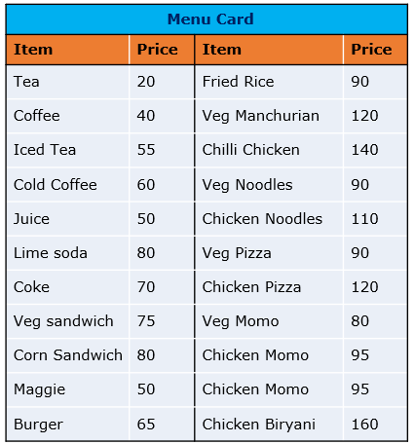
Project Problem
Problem Statement
We have the sales data of a restaurant of the last 15 days. It consists of details on the time of customer visit, type of orders, the amount spent against the orders by the customers, etc.
The restaurant provides a variety of menus.
However, the management wants to take action on cost-cutting and improving the profit.
Analyse the data and help them by providing actionable insights with the visual representation of data analysis to justify your suggestions.
www.anudip.org
FOLLOW US ON:

Slide 5

Tasks
Analyse the data given in the Excel file and create a report. The report may contain multiple pages as per requirement.
The group members need to create tables and charts, analyse data and find out:
Which item is sold the most and which item is sold the least?
Are more units ordered against lower-priced items or higher-priced items in a single order?
What items are sold more and what items are sold less in what type of meal?
Sale of which items in what type of meal generate a greater amount of sales?
Should the company continue offering all items at different times of the day?
Actionable insights from the analysis for cost-cutting and improving the profit
Double-click the excel file to see the expense details.
**Note: The excel file is also available on LMS. You can download it from there too.
www.anudip.org
FOLLOW US ON:

Slide 6
Action Items
All members to brainstorm and complete the tasks | Item-wise order quantity Which Items have been ordered most and which items have been ordered least? What will be your conclusion based on this?
 | Find out for which item more units are ordered in a single order. Do we observe more units ordered against lower-priced items or higher-priced items?
 | Visually present the following in a single view: The percentage of sales amount generated for each item in different types of orders; we should be able to filter the order type The total quantity ordered for each item in different order types; we should be able to filter the items ordered Identify the 3 top selling items and 3 least selling items in each order type in terms of quantity Identify 3 items that are contributing higher to the sale amount and the 3 items that are contributing much less to the sales amount
 | Find out: Which are the items being ordered by customers in at least 3 meal types? Which are the items being ordered in more than one meal type? What insights do we get from this? Should we discontinue any of these items, and why?
The group members need to copy the tables and charts along with the findings to a ppt or a document for presentation.
www.anudip.org
FOLLOW US ON:

Slide 7
Presentation and Scoring
Each group needs to create a presentation (in Word file or a ppt) covering the following points:
Tables and charts based on given data
Findings from the tables and charts
Screenshots of the Power BI report page(s)
Actionable insights from the charts and suggestions to the company on cost-cutting and improving profit
Each member needs to upload the project ppt/document file created by the respective group to the LMS.
The facilitator will give score to each group and its members as per the scoring instructions and template given in Project Guide.
*** The facilitator needs to score the project-based behavioural components at the end.
www.anudip.org
FOLLOW US ON:

Slide 8


